Slide 1



Tech Circles
Full Stack Engineering Community

Slide 2

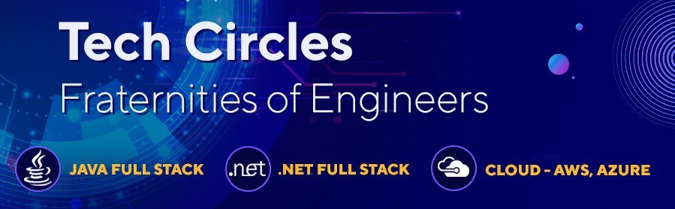


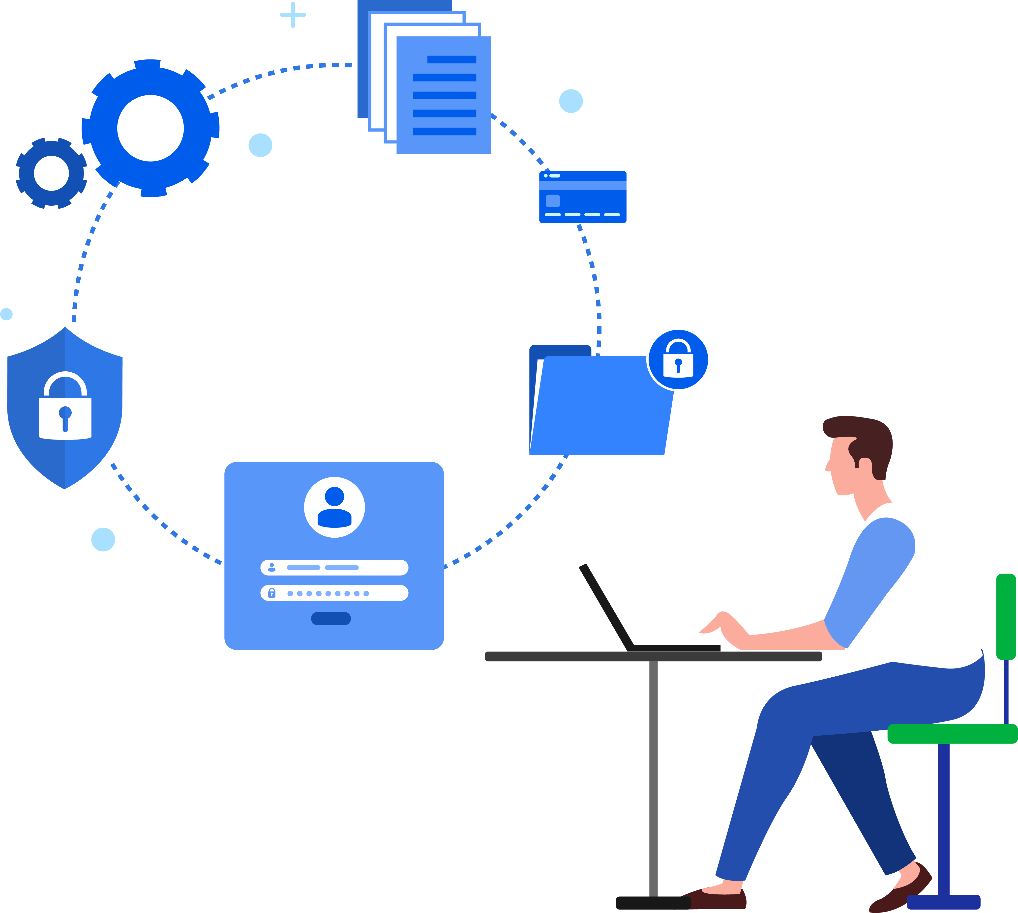
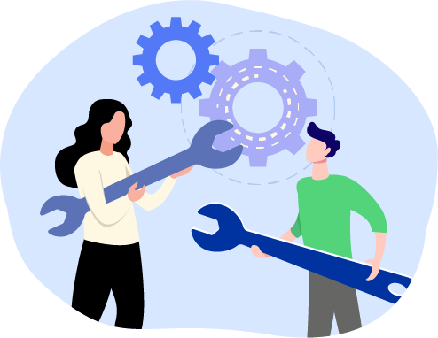
FSE Tech Circles
Designed as a Fraternity of Engineers in FSE community, TechCircles are a crucible for Knowledge exchange, fosters Innovation and ushers New thinking.
1
3
4
Knowledge
2
Information & Collaboration
Innovation
Problem Solving
Incubate new thinking / Study specific technology areas
Develop and Showcase PoCs
House Knowledge Assets, Best Practices, Case Studies
Track new Technologies
Drive Innovative Thinking
Develop Tools, Utilities, Harvest Existing Assets
Provide Information to queries, Help Associates seeking Help
FAQ Corner/ “How to” Solutions

Slide 3

What do Tech Circles do - Organize, Contribute, Collaborate
TedTalks
Quiz
We have close to 950 Associates as part of our Tech Circles in Q1
Java FSE and Cloud have 350 Associates each, with .Net FSE having 250 associates
Engineers Day
Show and Tell Demos
Project Knowledge Sharing
Code Challenge
Fun Events

Slide 4
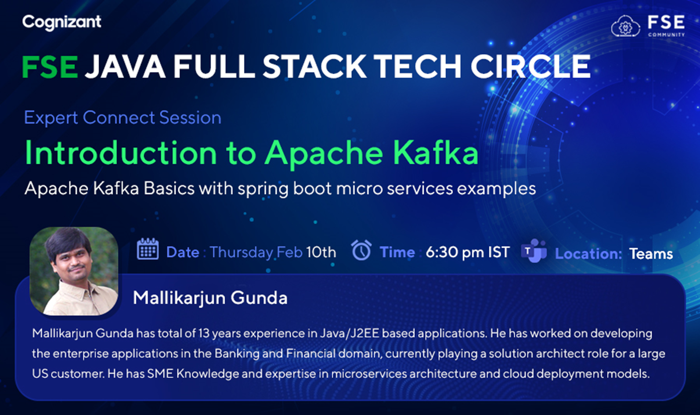
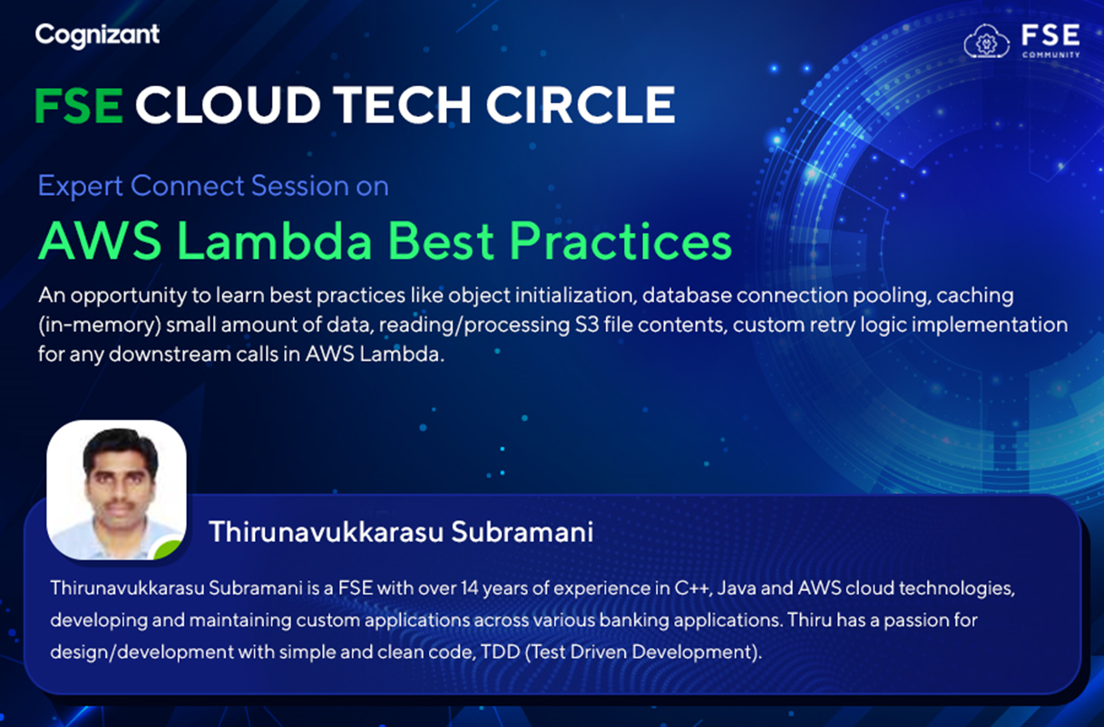
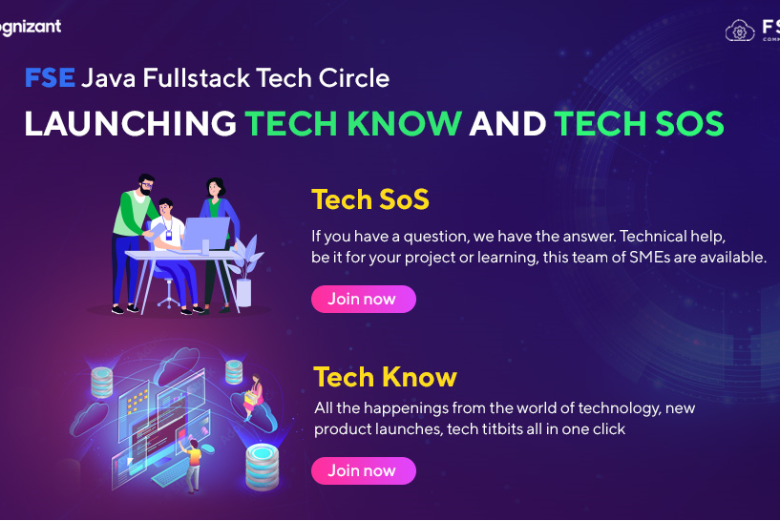
Some Snippets of Tech Circle Activities in Q1 2022
https://cognizantonline.sharepoint.com/:v:/s/FSETechCirclesCognizant/EXb-pAVGkNFAsZfsrthS-SYBbKyww_wGE15NFiXkYm4ytg?e=Q8JSqG
FSE Tech Circle _ Introduction to Apache Kafka with Spring Boot in Microservices-20220210_130352-Meeting Recording.mp4
FSE Cloud Tech Circle _ AWS Lambda Best Practices & Case Studies-20220215_183411-Meeting Recording.mp4
Tech Circle Blogs
Cross Platform development with .Net MAUI
Role based Access Control
Couchbase Concepts
Worker Service in .Net Core
Front Door In Azure in Wiki

Slide 5
Join a Tech Circle Today – Reach out to our PoCs !!
Key Contacts
Tech Circle Leads
Java FSE Tech Circle – Dinesh DineshKumar.PeriyasamyKrishnan@cognizant.com
.Net FSE Tech Circle – Karthik Karthik.Aruchsamy@cognizant.com
Cloud Tech Circle – Renu Renu.KumariPandey@cognizant.com
CM Sponsors
Swaminathan swaminathan.c@cognizant.com
Duvvru Vishnupriya Vishnupriya.Duvuru@cognizant.com

Slide 6
Thank You

